Slide 1




What's your next step
Now what to do next? What not to do? Don't worry, we will tell you what should be your next step!

Slide 2
How will we help you
We have a wonderful team that will help you reach your success.
We are always available to help you.
Our team also motivate you.
We give our best to help you.

Slide 3

Our team
As your requirement we have different type of team.
For your education related issue we have PhD holders, university professor.
For your business related issue we have successful businessmen & advisor.
For your dream related issue we have great engineer team.
For finding your interest subject related issue we have govt. Teacher as well as advisor.
For what you do after 10th,12th and graduation we have experienced team.

Slide 4
How can we help you
For taking our help you will follow some step.
First of all we provide our e-mail id/contact us form.
You can share your problem by sending a mail or submitting your problem.
send us mail with your name, your time slot and your problem.
It’s a totally secret process.
As per your time slot we will provide a solution from our team.

Slide 5
It’s just FOUR steps

Slide 6
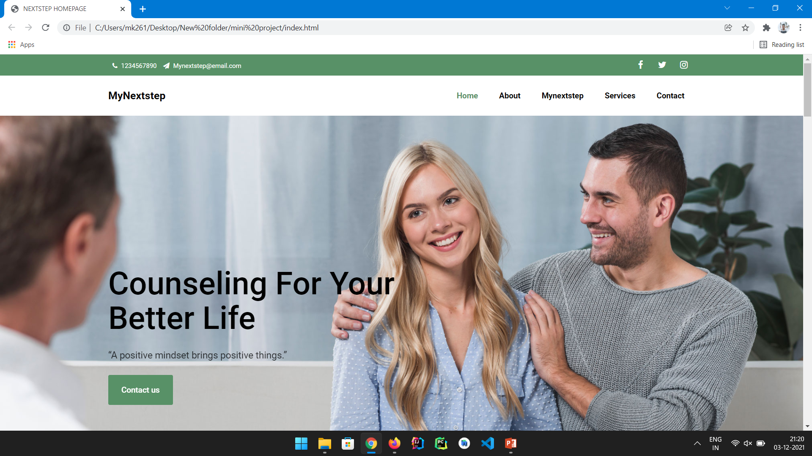
Open MyNextStep

Slide 7
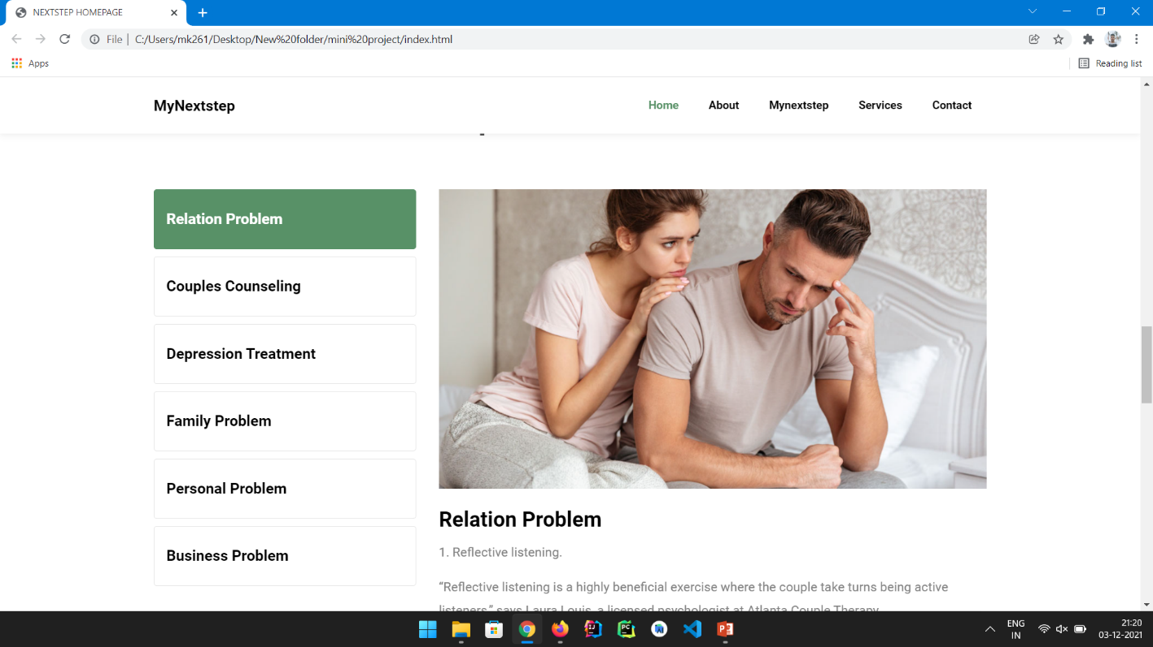
Scroll down and look for your Problem

Slide 8

Did not find a Solution, Scroll up and click on contact us!

Slide 9
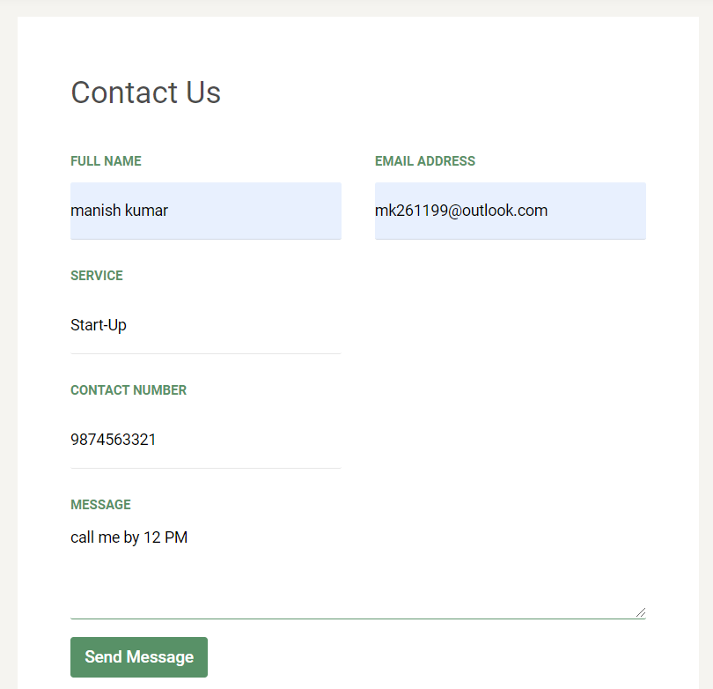
Let us know your Quarry, and we will call you!

Slide 10
MyNextStep
Always there for YOU!!

Slide 11
Thank You
Manish Kumar(191500436)
Aditiya Narayan Nagde(191500059)
Abhishek Sharma(191500037)
Nikhil Dubey(191500495)
Himanshu Goyal(191500344)

